Slide 1

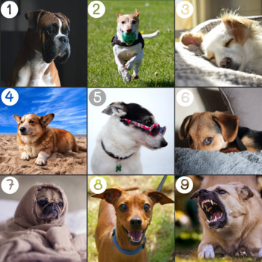
Supporting Behaviour and Emotional Regulation
Dr Emma Woozley (Educational Psychologist)

Slide 2



The Plan for Today
To use some ideas from psychology to think about supporting big feelings and behaviour
To develop some ‘scripts’ you can use with your child(ren) at home when they are experiencing big emotions
To listen to each others’ experiences and ideas – you are experts in your children!
There are no silly questions!

Slide 3
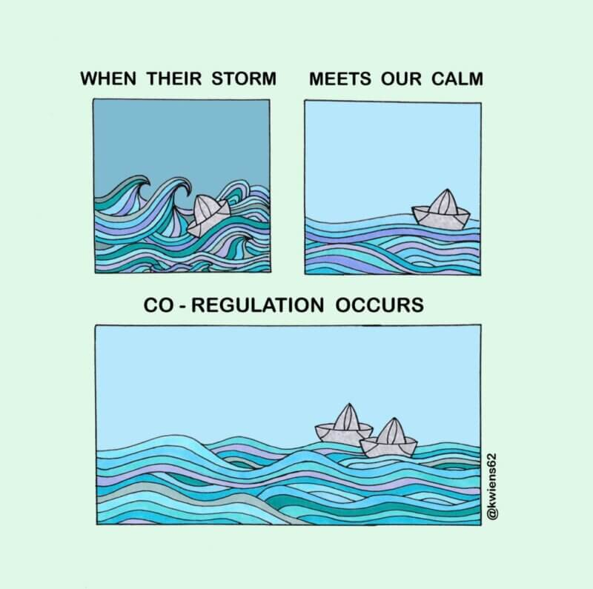
What is Coregulation?
Helping children manage their emotions by staying calm, connected, and supportive.
Adults act as a “steadying presence” when children feel overwhelmed or dysregulated.
Coregulation is based on the idea that children learn to self-regulate by first being regulated by trusted adults.

Slide 4
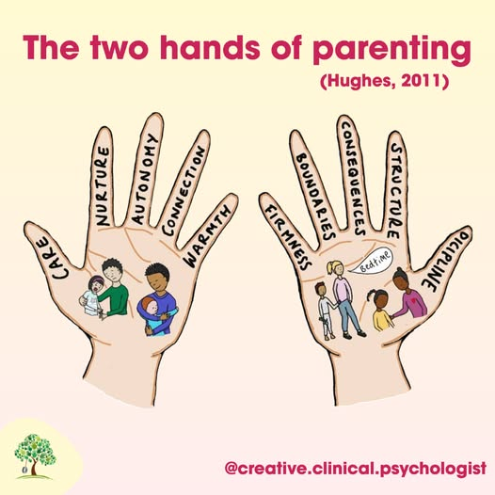
Empathy
(connection)
Limit setting
(correction)

Slide 5

How might a child feel if we only correct behaviour and don’t connect with them?
Equally, how might a child feel if we connect with them, but don’t help them correct their behaviours?

Slide 6




How to Emotion Coach
“All emotions are acceptable, but not all behaviours are acceptable”
Step 1
Recognise the child’s feelings and empathise with them
Step 2
Validate and label the child’s feeling
Step 3
Set limits on the behaviour (if needed)
Step 4
Problem solve with the child (if needed)
Connection
Correction

Slide 7
How to Emotion Coach
Need to really try to see things from your child’s point of view. This doesn’t mean you have to agree with them – it just means imagining how you might feel if you were in their shoes.
Remember that all emotions are normal. Children don’t choose how they feel and strong feelings happen to everyone.
Recognise behaviour is a way of communicating
Look for clues in your child’s body language, tone of voice and behaviour to understand what might be going on for them
Step 1
Recognise the child’s feelings and empathise with them

Slide 8
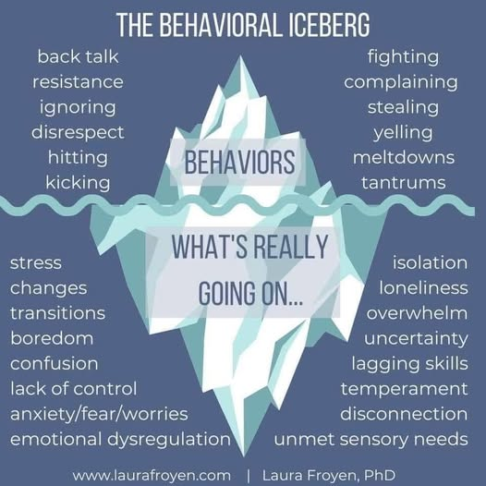
Activity
Using your handout…(page 1 only)
Think of a time when your child was showing particularly challenging behaviour
Write down what behaviour you saw ‘above the water line’
Write down what feelings they might have been experiencing ‘below the water line’ (use ‘I statements’)

Slide 9
How to Emotion Coach
Use words to reflect back your child’s emotion and help them to label the emotion
Simply observe – saying what you see rather than asking lots of questions to which young people might not know answer
Telling the emotional person that you understand their emotional situation and that you don’t blame them helps soothe their emotional brain
Step 2
Validate and label your child’s feeling

Slide 10


How might you describe and label these emotions?
E.g. “I can see that…I wonder if you’re feeling…”

Slide 11
How to Emotion Coach
We need to validate the emotion and label the feeling (as we have talked about) …BUT…certain behaviours cannot be accepted
‘It’s ok to be angry but it is not ok to shout at your friend’
‘This is not a safe place to be angry’
‘We can’t behave like that even though you are feeling annoyed because you might get hurt’.
Make sure you are doing step 1 and 2 first!
Step 3
Set limits on the behaviour (if needed)

Slide 12
How to Emotion Coach
Exploring the incident/behaviour and suggesting ideas and actions that could be more helpful next time
  Exploring – helping the child to understand the feelings that gave rise to the behaviour
  Identify alternatives – supporting the child to think of what they could have done instead
  Suggest solutions – choosing the best option for next time
Step 4
Problem solve with the child (if needed)

Slide 13
Developing a Script
Using your handout…
Think about a time when your child was experiencing big feelings and/or behaviour you found challenging.
Try to write down the actual words you would use with your child in this particular scenario. There are a number of prompts and suggestions to support you.
We will be spending the rest of the session on this activity.

Slide 14

Questions and reflections

