Slide 1
Samuel Cody
Badminton 2.12.21
Mrs Gurung
Mrs Bouzidi

Slide 2
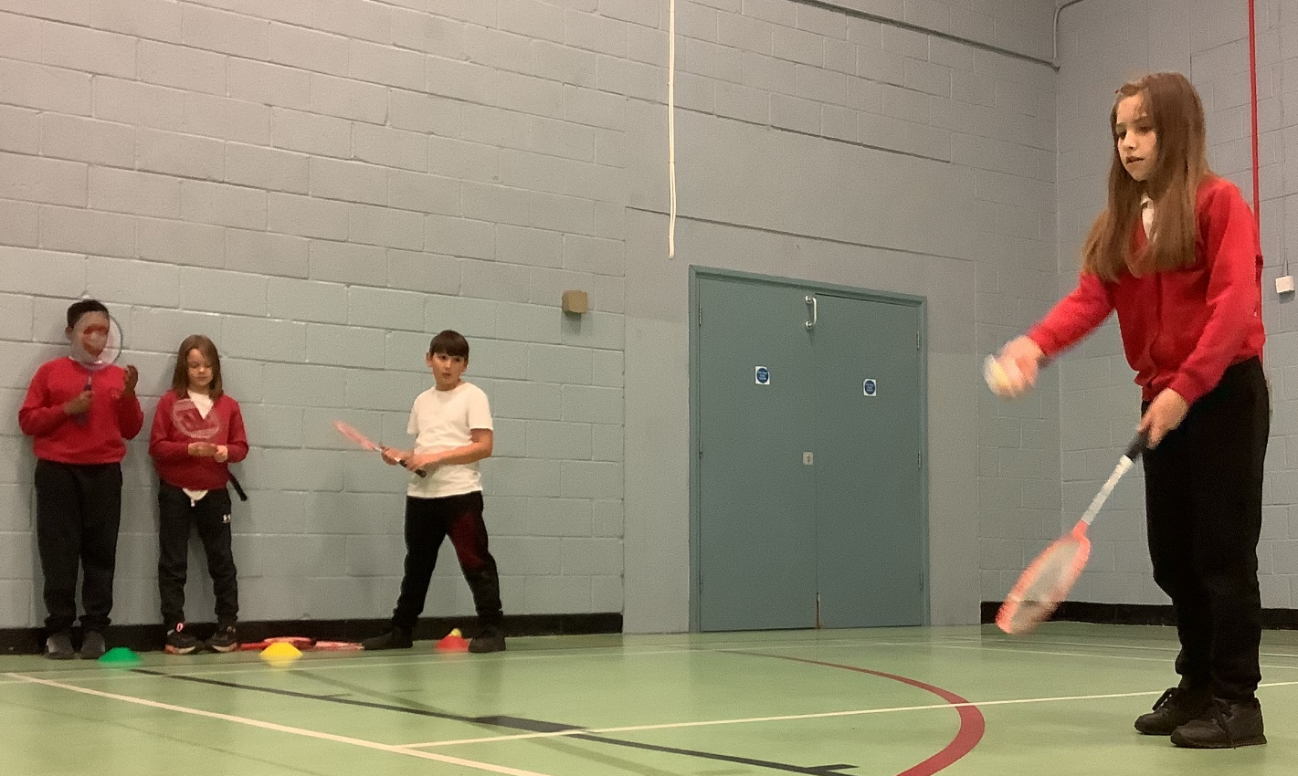
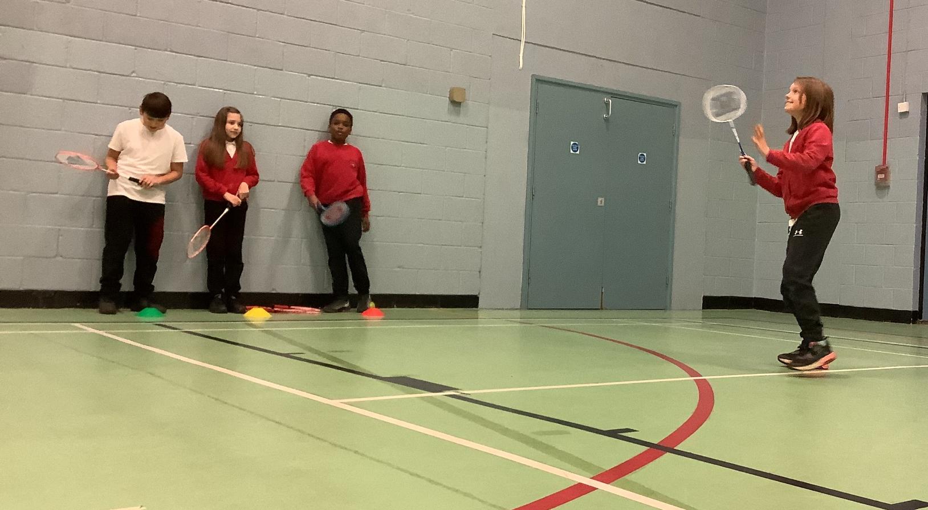
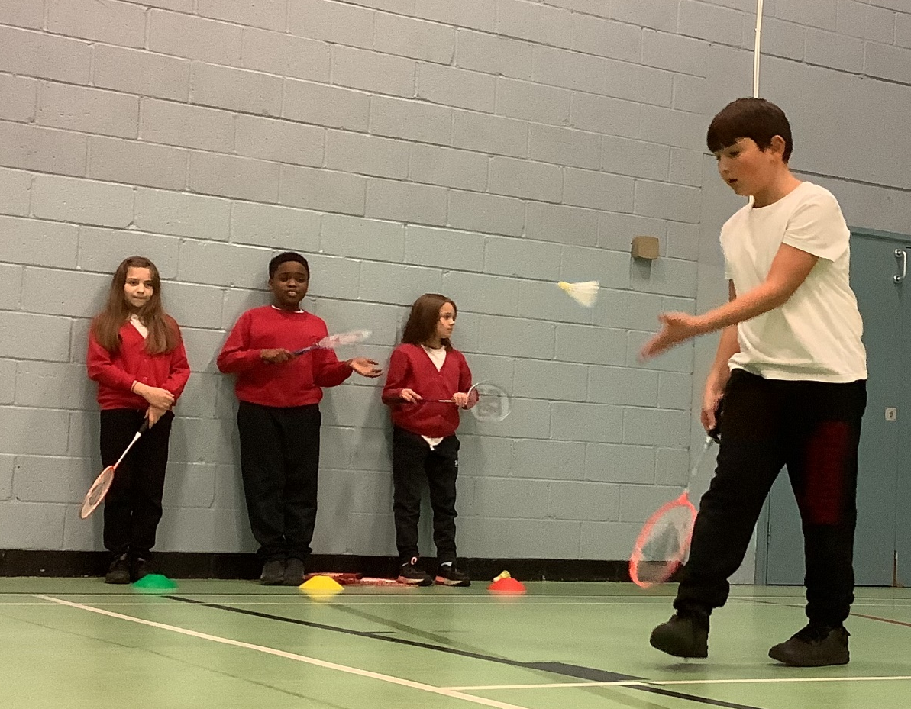
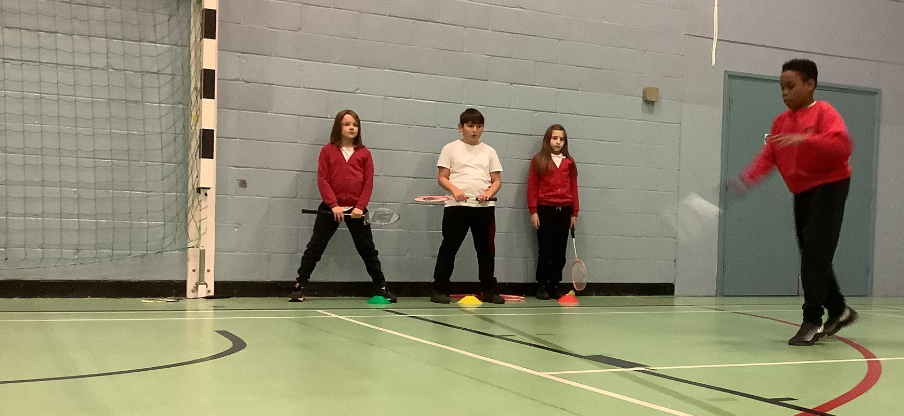

Slide 3
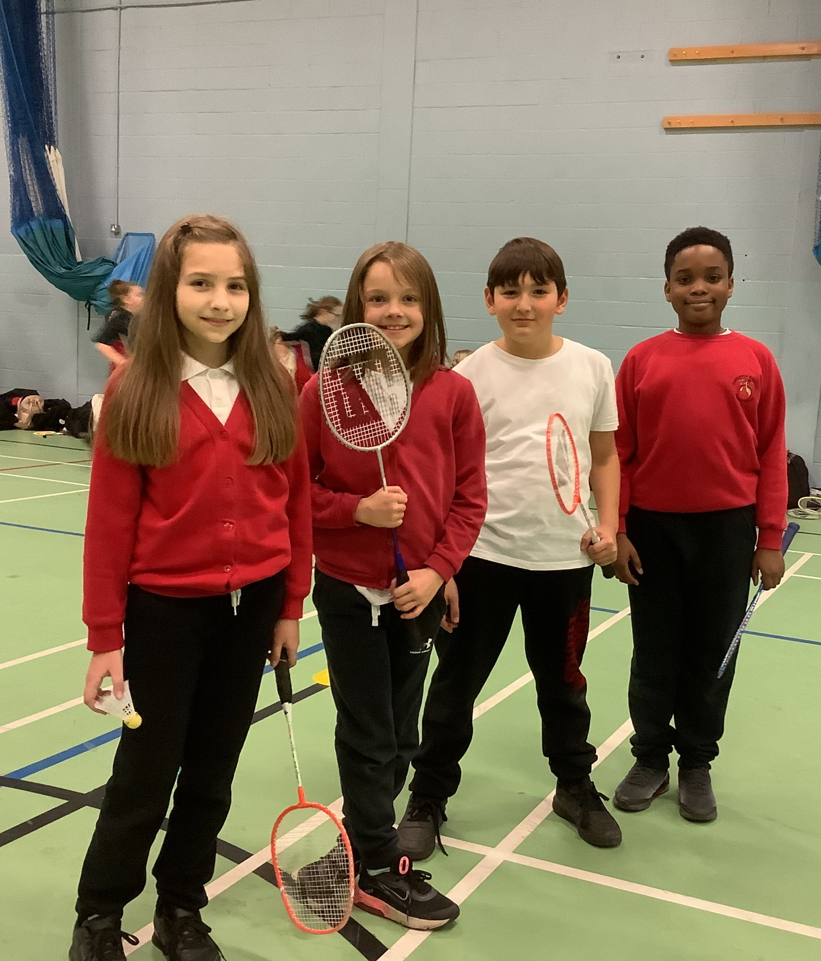
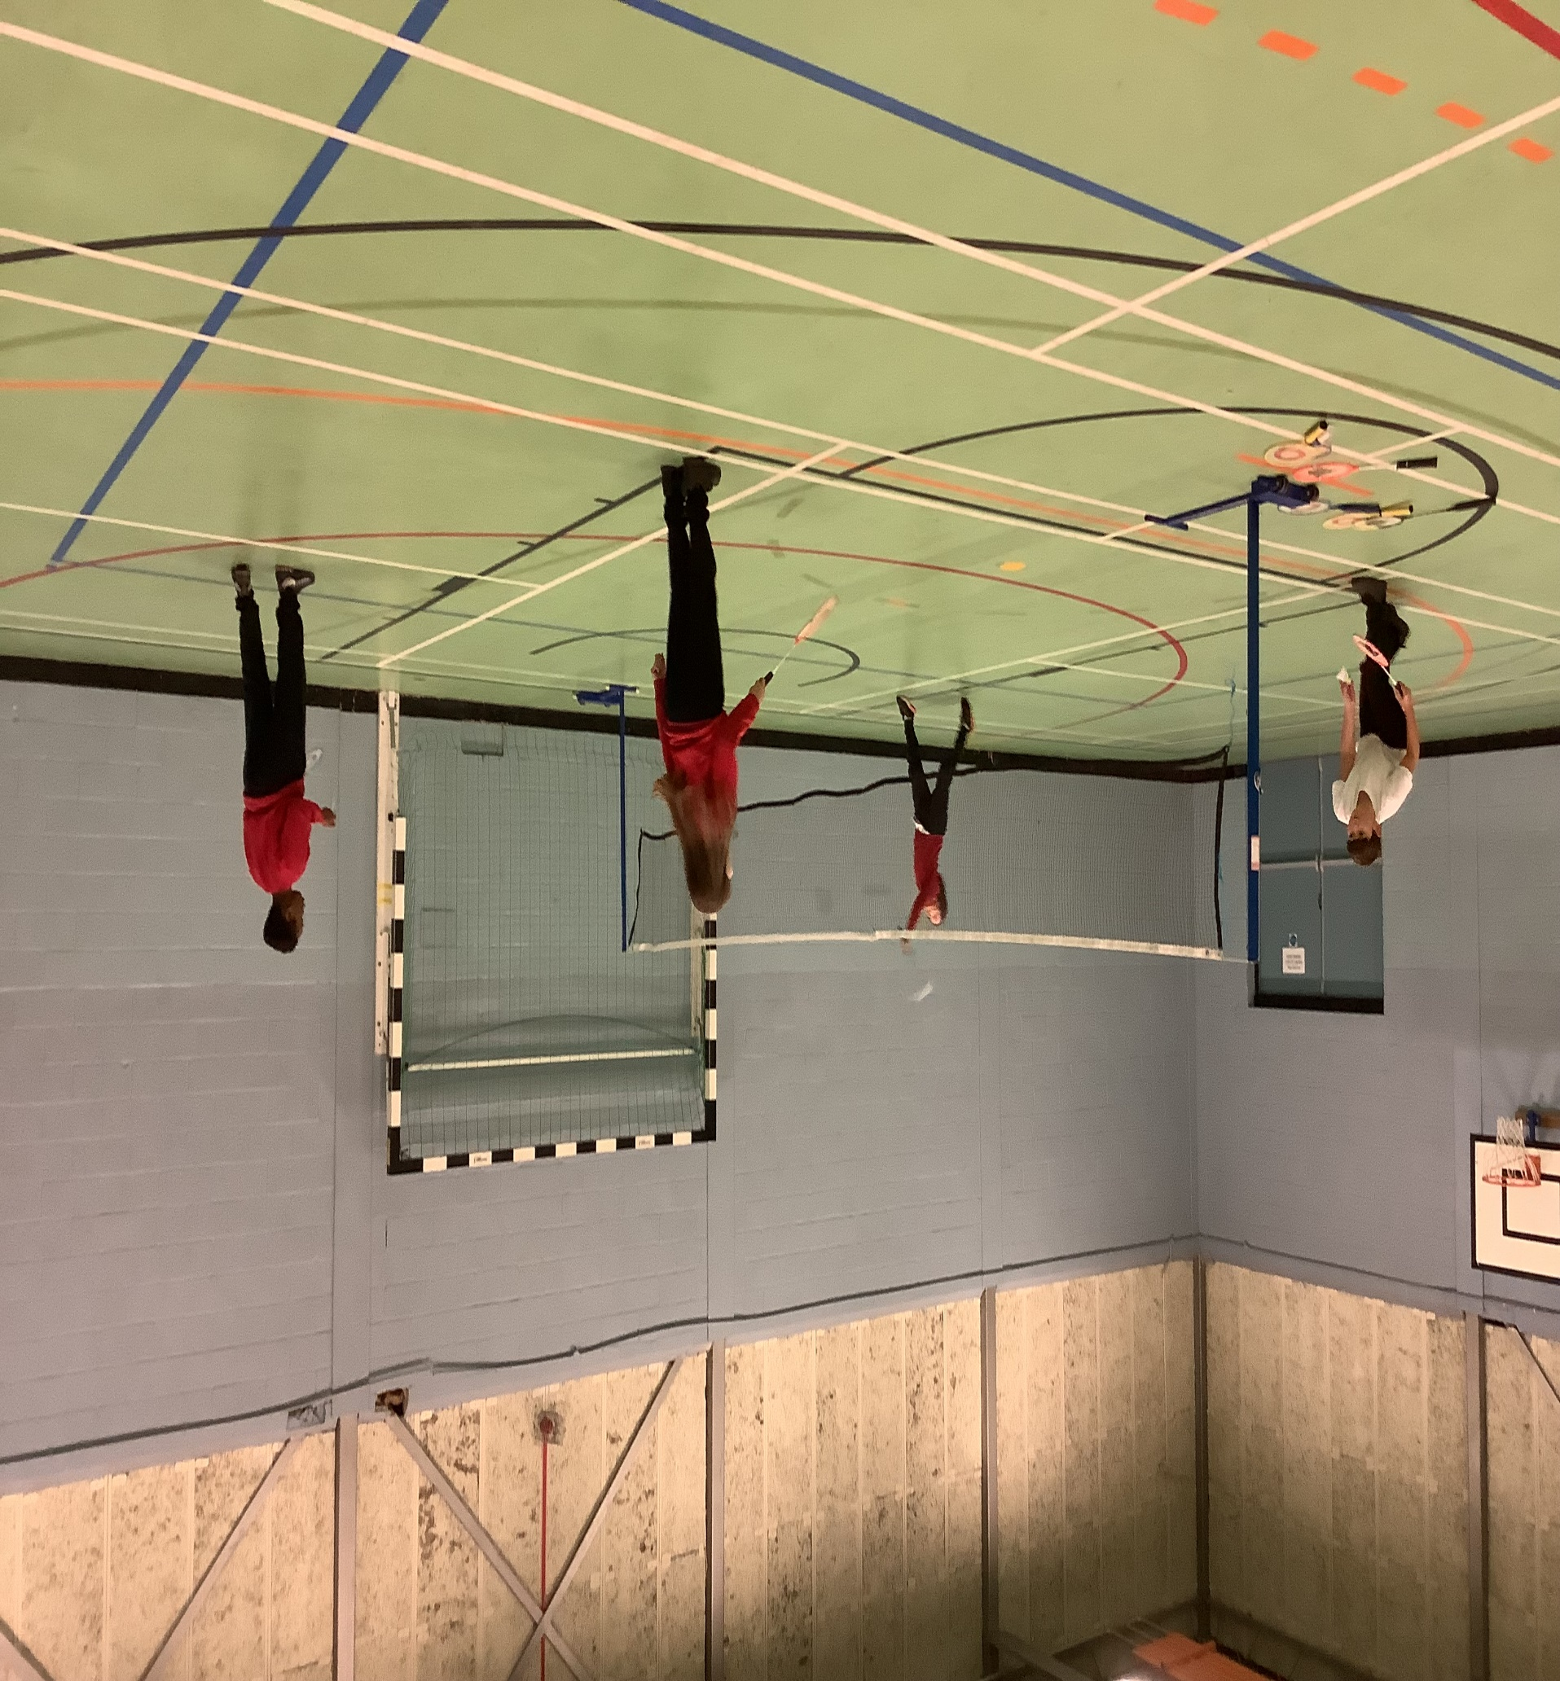

Slide 4

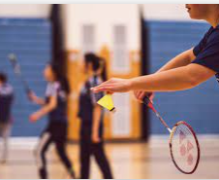
Our thoughts….
Zoe – I improved on my returning skills
Liban– I enjoyed playing against all the different teams
Mehmet – I was better with focusing and concentrating when hitting the shuttlecock
Yulia – I enjoyed serving the shuttlecock (underarm)

Slide 5
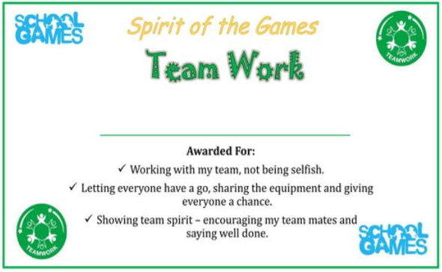
Certificate to children

Slide 6

Player of the Match
She tried her best in every game – improved her serving and receiving skills. She was beginning to be strategic with where she landed her shuttlecock on the opposite team’s court. She always played with a smile ☺
Yulia

