Slide 1
Samuel Cody
Table Tennis 9.11.21
Mrs Gurung, Mrs Butler

Slide 2
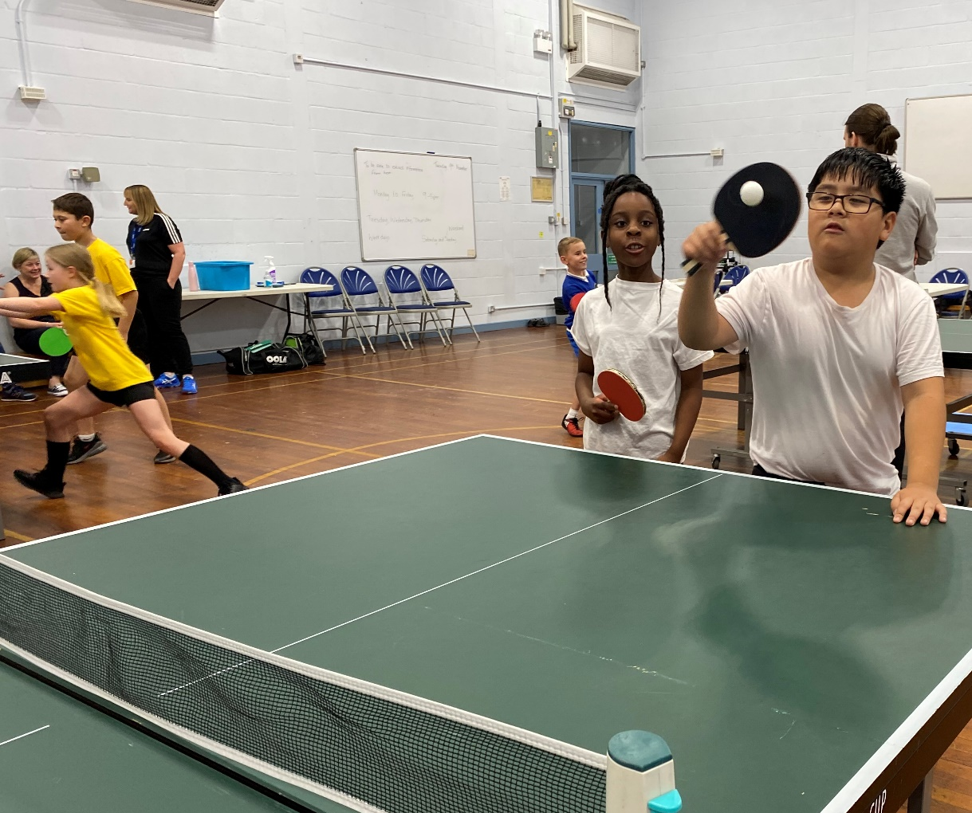
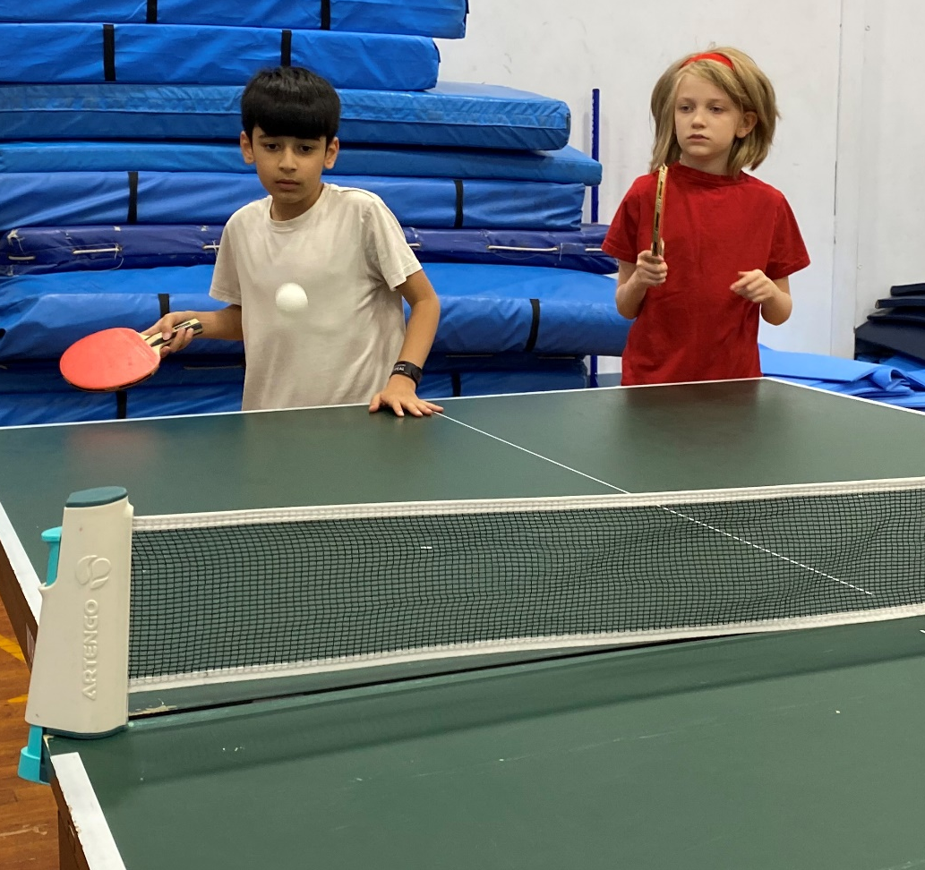
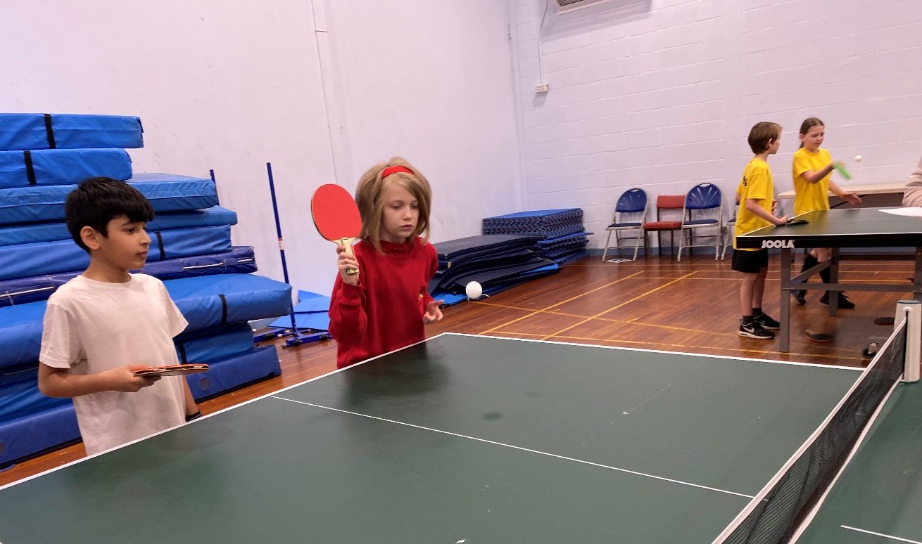
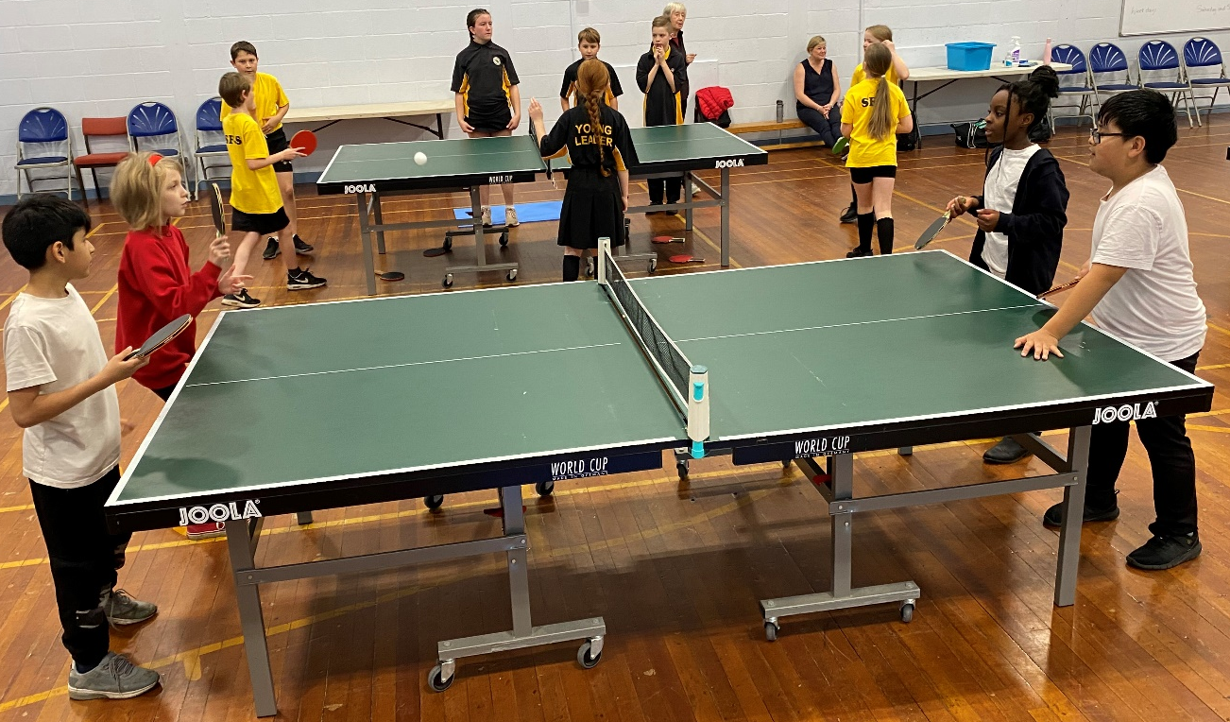

Slide 3
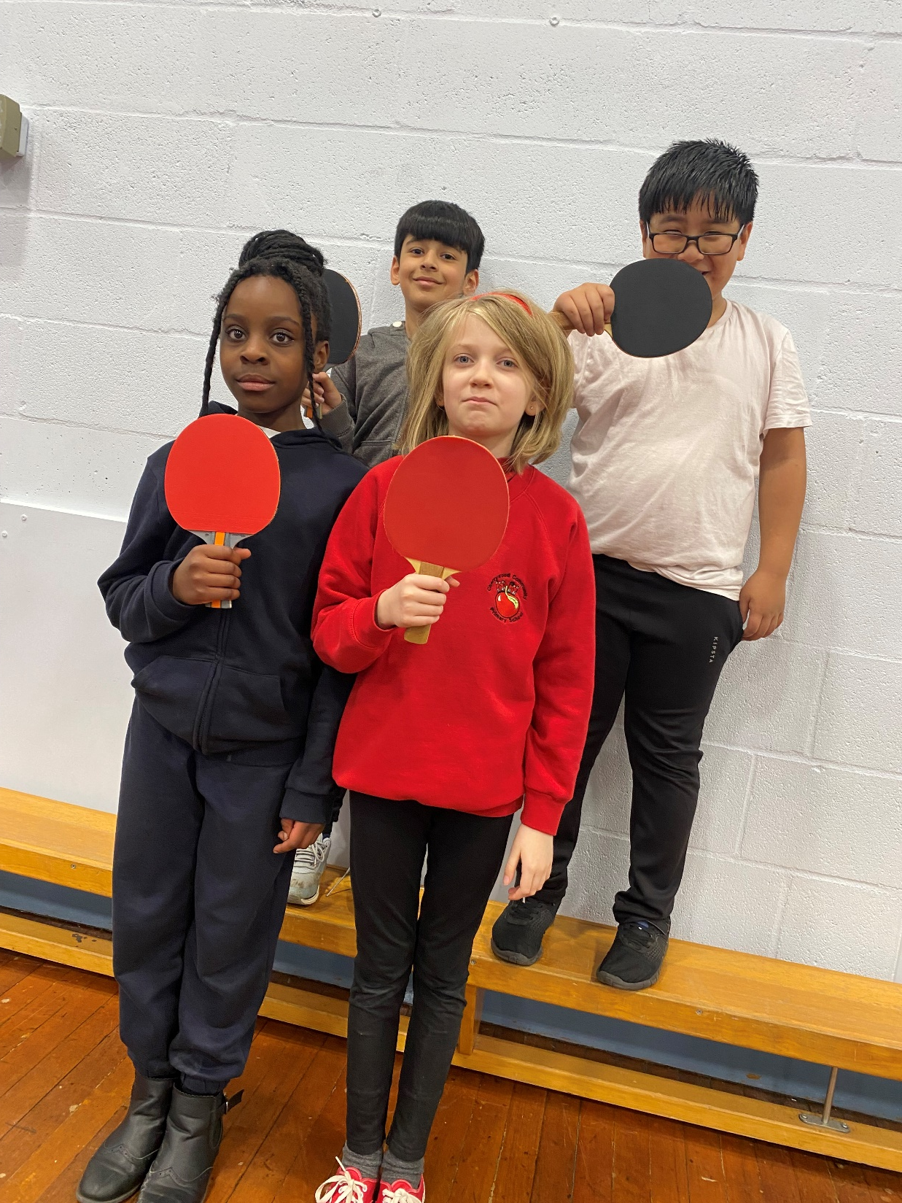
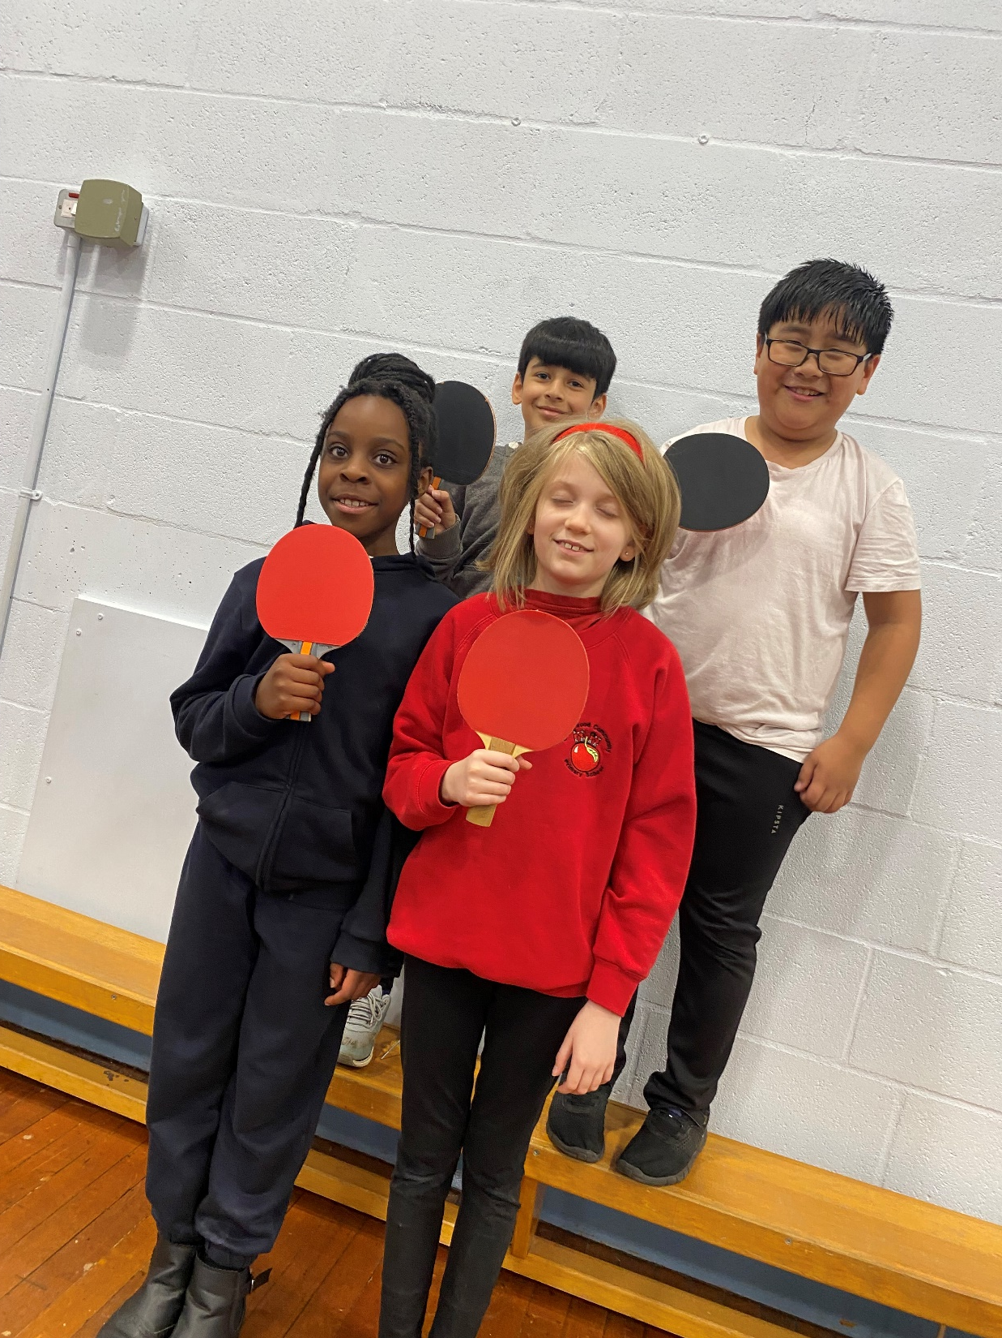

Slide 4

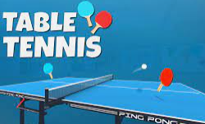
Our thoughts….
Benny – I really improved my shots as the games went on
Adarsh – I improved my knowledge of rules – not hitting the ball back if it doesn’t land on our side of the table
Willow – I improved my serves
Murtaza – I improved on aiming my shots and bouncing it at the right height

Slide 5
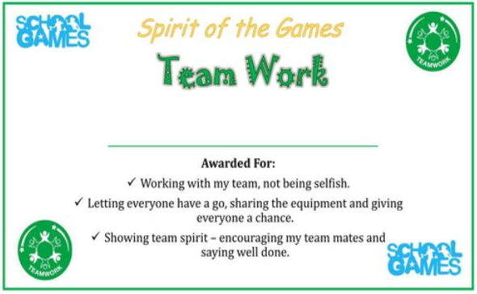
Certificate to children

Slide 6

Player of the Match
He tried his best in every game – understood what skill was needed and wanted to improve himself. Great perseverance and positive attitude towards himself.
Murtaza

